Slide 1
Introductory Economics for Business and Finance (IC103)
Tutorial 4 - answers

Slide 2
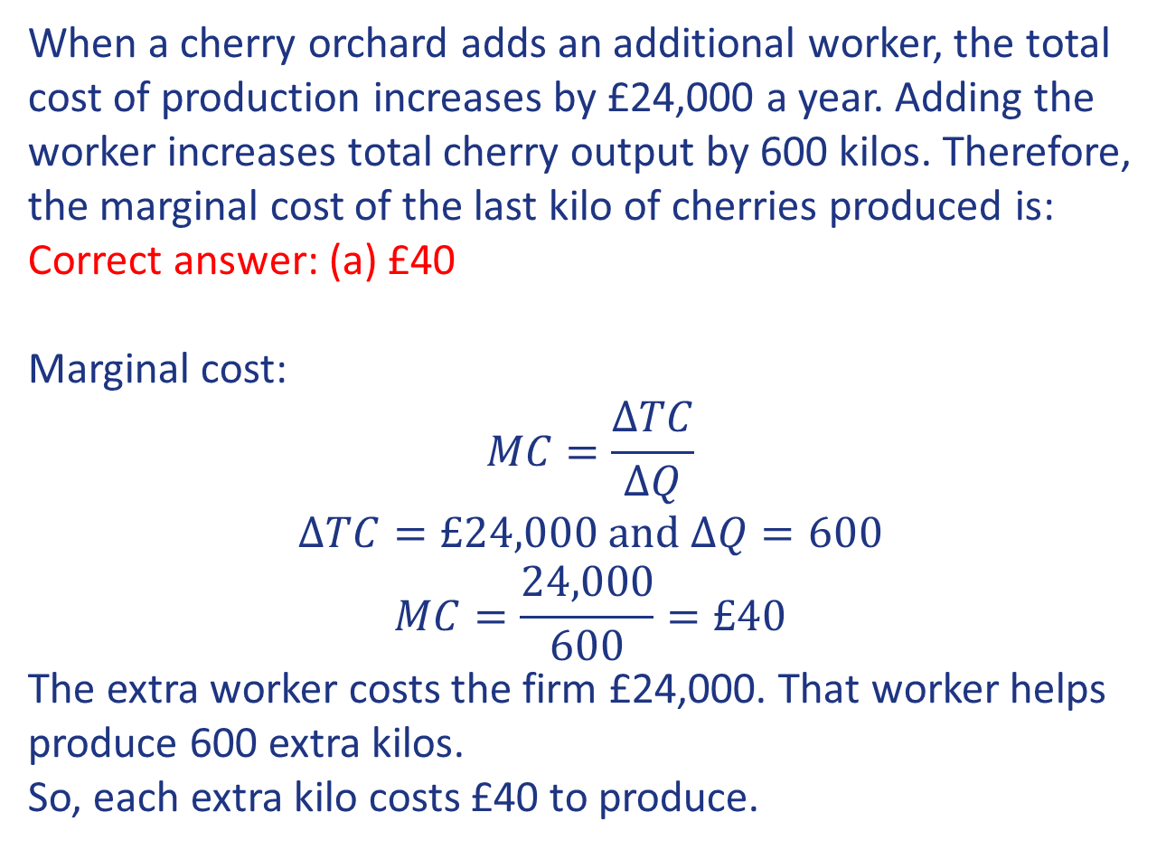
Question 1
When a cherry orchard adds an additional worker, the total cost of production increases by £24,000 a year. Adding the worker increases total cherry output by 600 kilos. Therefore, the marginal cost of the last kilo of cherries produced is:
Correct answer: (a) £40
Marginal cost:
$$MC=\frac{ΔTC}{ΔQ}$$
$$ΔTC=£24,000 and ΔQ=600$$
$$MC=\frac{24,000}{600}=£40$$
The extra worker costs the firm £24,000. That worker helps produce 600 extra kilos.
So, each extra kilo costs £40 to produce.

Slide 3
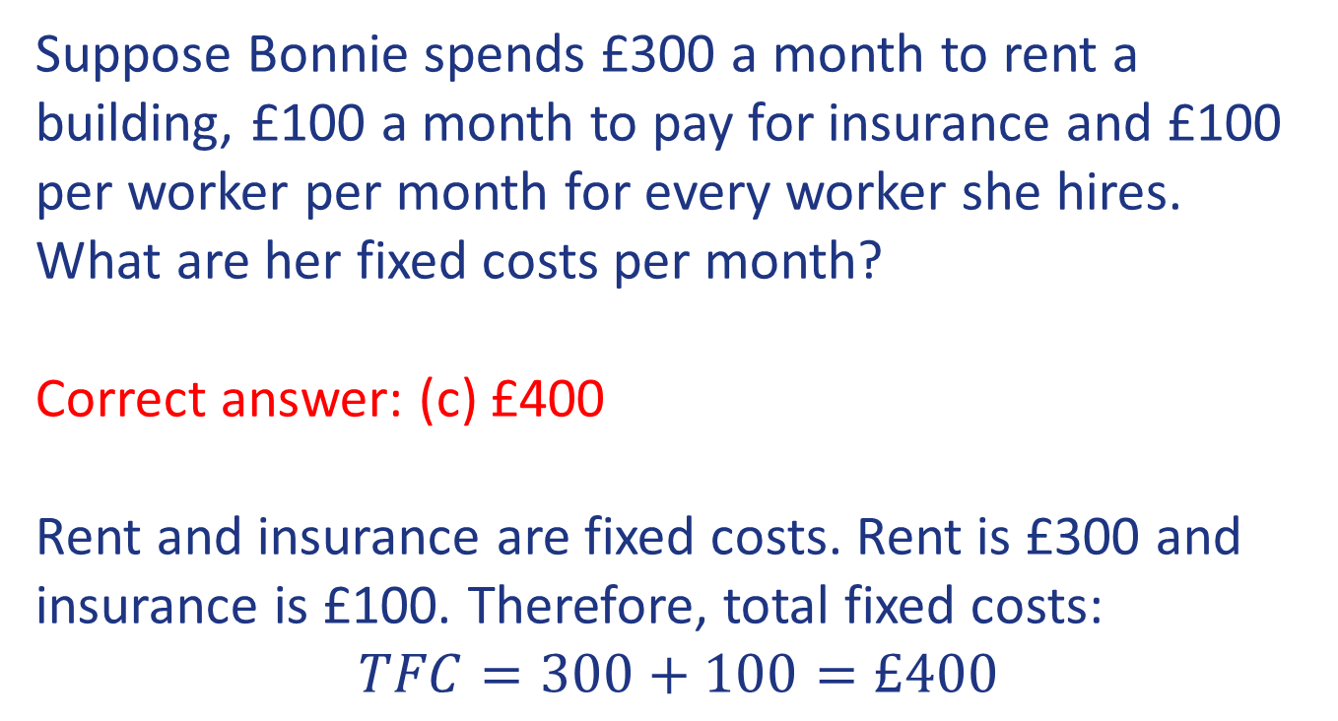
Question 2
Suppose Bonnie spends £300 a month to rent a building, £100 a month to pay for insurance and £100 per worker per month for every worker she hires. What are her fixed costs per month?
Correct answer: (c) £400
Rent and insurance are fixed costs. Rent is £300 and insurance is £100. Therefore, total fixed costs:
$$TFC=300+100=£400$$

Slide 4
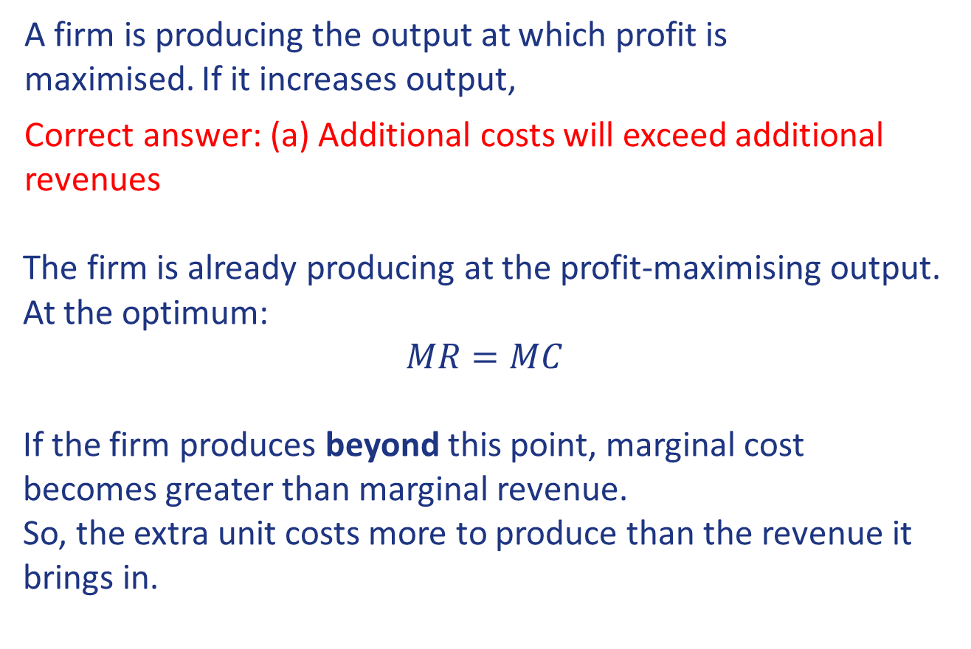
Question 3
A firm is producing the output at which profit is maximised. If it increases output,
Correct answer: (a) Additional costs will exceed additional revenues
The firm is already producing at the profit-maximising output. At the optimum:
$$MR=MC$$
If the firm produces beyond this point, marginal cost becomes greater than marginal revenue.
So, the extra unit costs more to produce than the revenue it brings in.

Slide 5
Question 3 (cont’d)
MC
16
12
8
Costs and revenue (£)
profit maximised where marginal revenue (MR) = marginal cost (MC)
4
e
0
1
2
3
4
5
6
7
Quantity
-4
MR

Slide 6
Question 4
For a market to be classified as perfectly competitive,
there must be
A large number of firms which cannot influence prices
Freedom of entry and exit
Indistinguishable products sold
All of the above
Correct answer: (d) All of the above
(a) (b) and (c) are the key distinguishing features of a perfectly competitive market

Slide 7
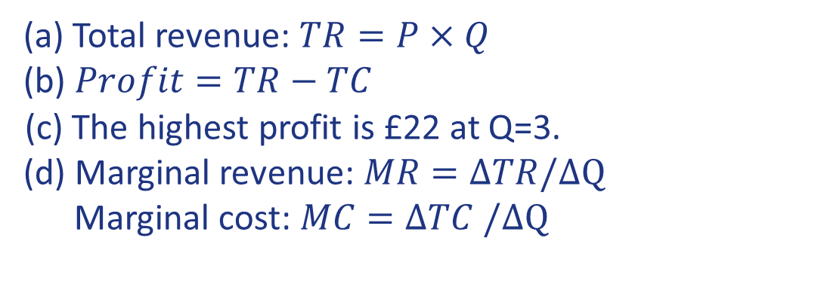
Question 5
(a) Total revenue: $TR=P×Q$
(b) $Profit=TR−TC$
(c) The highest profit is £22 at Q=3.
(d) Marginal revenue: $MR=ΔTR/ΔQ$
Marginal cost: $MC=ΔTC$ $/ΔQ$
Output | Price (£) | Total cost (£) | (a) Total revenue (£) | (b) Profit (£) | (d) MR (£) | (d) MC (£)
0 | 20 | 10 | 0 | -10 | - | -
1 | 18 | 15 | 18 | 3 | 18 | 5
2 | 16 | 18 | 32 | 14 | 14 | 3
3 | 14 | 20 | 42 | 22 | 10 | 2
4 | 12 | 27 | 48 | 21 | 6 | 7
5 | 10 | 41 | 50 | 9 | 2 | 14

Slide 8
Question 6
A firm has fixed costs of £60 and variable costs as indicated in the table below.
Complete the table.
At what level of output diminishing marginal returns occur?
Total Product | Fixed Cost (FC) | Variable Cost (VC) | Total Cost (TC) | Average Fixed Cost (AFC) | Average Variable Cost (AVC) | Average Cost (AC) | Marginal Cost
0 |  | 0
1 |  | 45
2 |  | 85
3 |  | 120
4 |  | 150
5 |  | 185
6 |  | 225
7 |  | 270
8 |  | 325
9 |  | 390
10 |  | 465

Slide 9
Question 6 (cont’d)
a)
Total Product | Fixed Cost (FC) | Variable Cost (VC) | Total Cost (TC) =FC+VC | Average Fixed Cost (AFC=FC/Q) | Average Variable Cost (AVC=VC/Q) | Average Cost (AC=TC/Q) | Marginal Cost MC=𝚫𝐓𝐂/𝚫Q
0 | 60 | 0 | 60 | - | - | - | -
1 | 60 | 45 | 105 | 60 | 45 | 105 | 45
2 | 60 | 85 | 145 | 30 | 42.5 | 72.5 | 40
3 | 60 | 120 | 180 | 20 | 40 | 60 | 35
4 | 60 | 150 | 210 | 15 | 37.5 | 52.5 | 30
5 | 60 | 185 | 245 | 12 | 37 | 49 | 35
6 | 60 | 225 | 285 | 10 | 37.5 | 47.5 | 40
7 | 60 | 270 | 330 | 8.6 | 38.6 | 47.1 | 45
8 | 60 | 325 | 385 | 7.5 | 40.6 | 48.1 | 55
9 | 60 | 390 | 450 | 6.7 | 43.3 | 50 | 65
10 | 60 | 465 | 525 | 6.0 | 46.5 | 52.5 | 75
b) Before Q=5, marginal cost is falling. At Q=5, marginal cost starts rising.
Rising MC reflects falling marginal productivity. Therefore, diminishing marginal returns have begun.

Slide 10
Question 7
A firm that is experiencing diminishing returns in management’s ability to use and disseminate information as it increases production in the long run is an example of
Correct answer: b) diseconomies of scale.
The question explicitly says: as the firm becomes larger and produces more, managers may find it harder to communicate, coordinate, and share information effectively.
For example, in a small firm, managers can communicate directly with employees. In a very large firm, there may be many departments and layers of management, so information can take longer to pass through the organisation or may be misunderstood.
As a result, the firm may become less efficient and its average costs may start to rise.

Slide 11
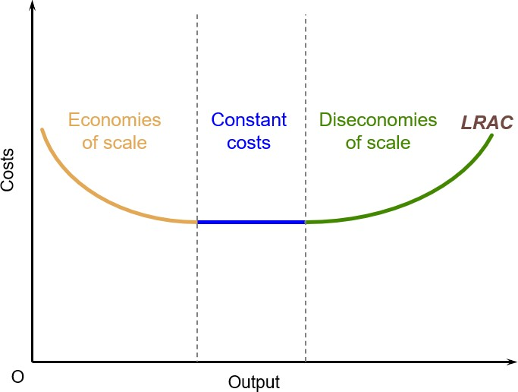
Question 7 (cont’d)

Slide 12
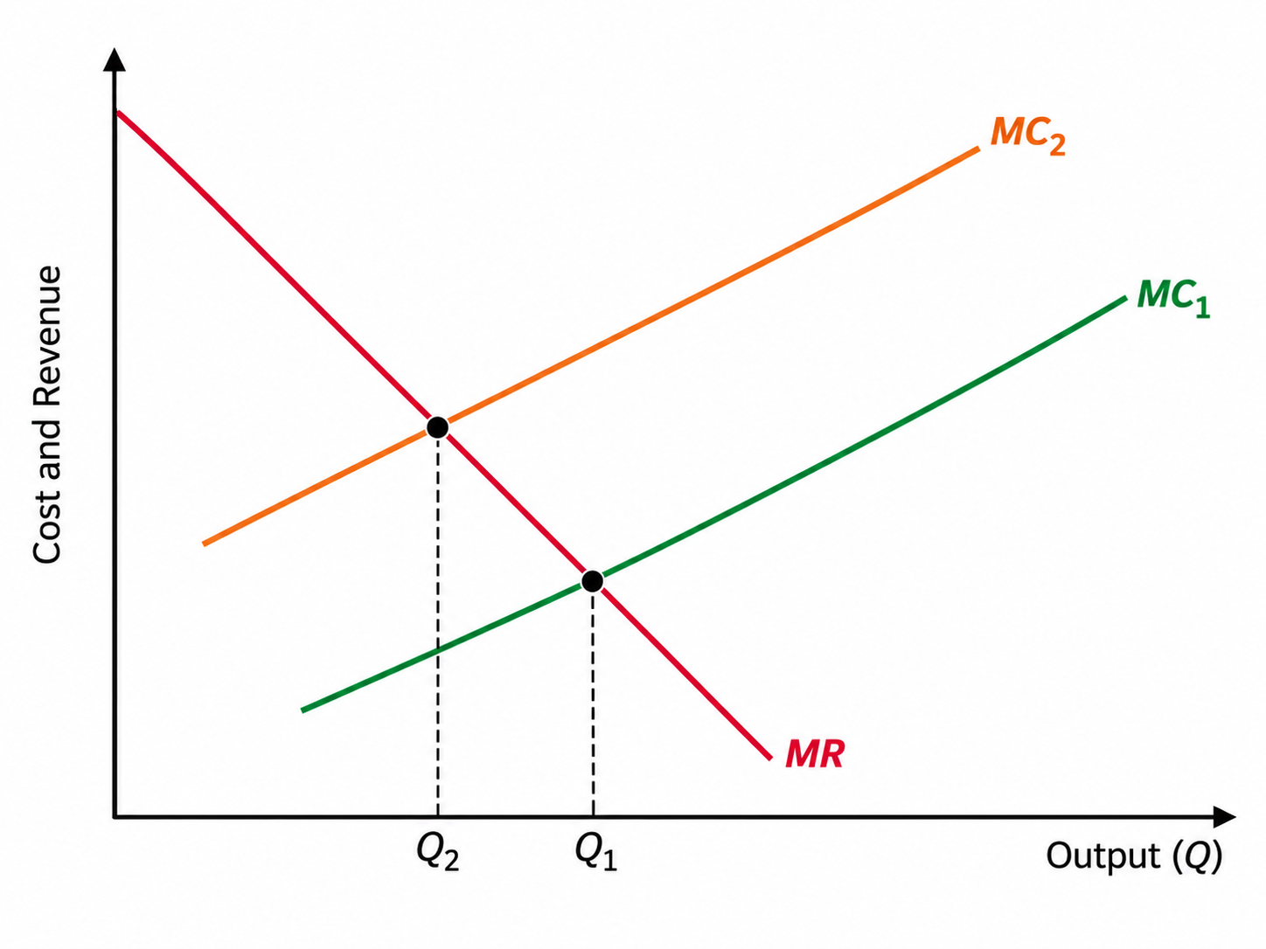
Question 8
A firm maximises its profit by producing at the level of output where marginal revenue (MR) equals marginal cost (MC). For each of the following scenarios, explain how the firm's profit-maximising level of output is likely to change.
An increase in marginal revenue at all levels of output.
MR increases, while MC is unchanged. The firm reaches MR = MC at a higher level of output. Therefore, profit-maximising output increases.
An increase in marginal costs at all levels of output.
  MC increases, while MR is unchanged. The firm reaches the point where MR = MC at a lower level of output. Therefore, profit-maximising output decreases.

Slide 13
Question 8 (cont’d)
An increase in consumer demand for the firm's product.
Higher demand increases the revenue the firm can earn from selling additional units, so MR increases. With MC unchanged, the new MR = MC point occurs at a higher output. Therefore, profit-maximising output increases.
An increase in transport costs following a rise in oil prices, assuming transport costs vary with output.
Because transport costs vary with output, they are variable costs. Higher transport costs therefore increase MC. With MR unchanged, MR = MC occurs at a lower output. Therefore, profit-maximising output decreases.
A recession that reduces consumer demand for normal goods.
Demand falls, so the revenue from selling additional units falls. Therefore, MR decreases. With MC unchanged, MR = MC occurs at a lower output. Therefore, profit-maximising output decreases.
Summary:
MC ↑ → output ↓
MR ↑ → output ↑
Demand ↑ → MR ↑ → output ↑
Variable costs ↑ → MC ↑ → output ↓
Demand ↓ → MR ↓ → output ↓

Slide 14
Question 9
In the traditional model of short run costs, the minimum of the ATC curve lies to the right (i.e. higher Q level) of the minimum for the AVC curve. Show this graphically and explain why this is the case.

Slide 15
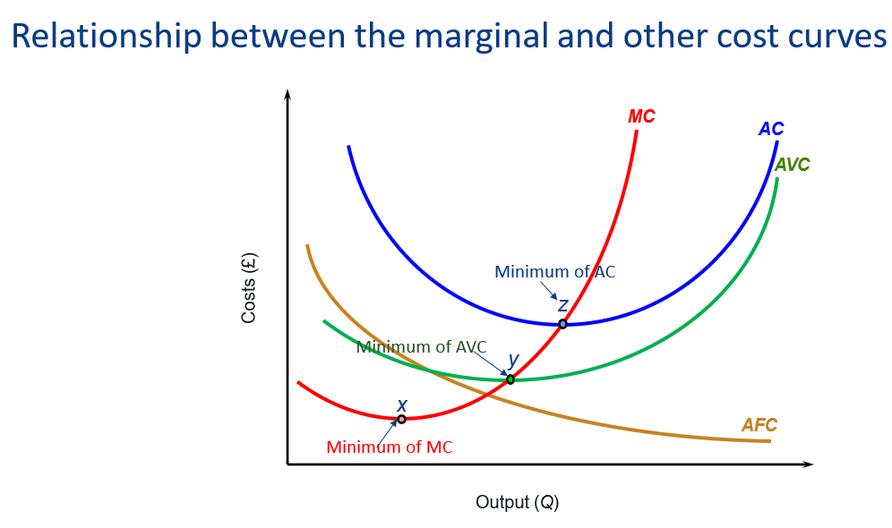
Question 9 (cont’d)
In the traditional model of short run costs, the minimum of the ATC curve lies to the right (i.e. higher Q level) of the minimum for the AVC curve. Show this graphically and explain why this is the case.

Slide 16
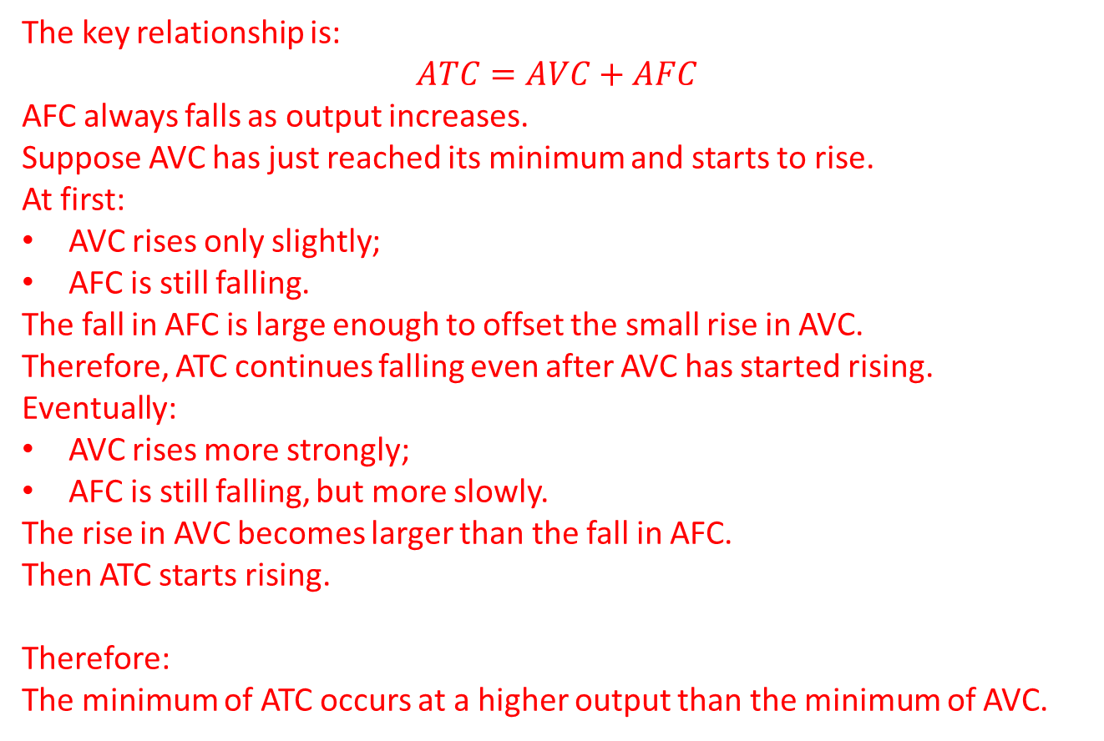
Question 9 (cont’d)
The key relationship is:
$$ATC=AVC+AFC$$
AFC always falls as output increases.
Suppose AVC has just reached its minimum and starts to rise.
At first:
AVC rises only slightly;
AFC is still falling.
The fall in AFC is large enough to offset the small rise in AVC.
Therefore, ATC continues falling even after AVC has started rising.
Eventually:
AVC rises more strongly;
AFC is still falling, but more slowly.
The rise in AVC becomes larger than the fall in AFC.
Then ATC starts rising.
Therefore:
The minimum of ATC occurs at a higher output than the minimum of AVC.

Slide 17
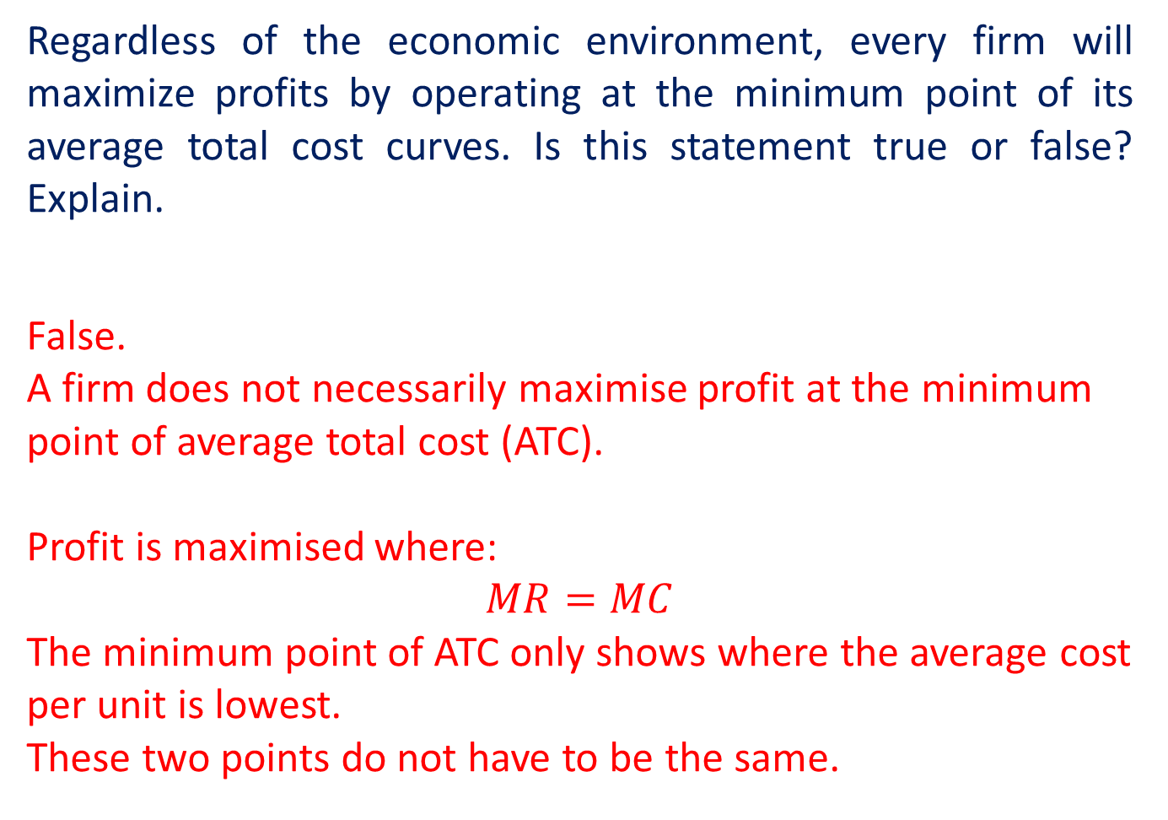
Question 10
Regardless of the economic environment, every firm will maximize profits by operating at the minimum point of its average total cost curves. Is this statement true or false? Explain.
False.
A firm does not necessarily maximise profit at the minimum point of average total cost (ATC).
Profit is maximised where:
$$MR=MC$$
The minimum point of ATC only shows where the average cost per unit is lowest.
These two points do not have to be the same.

Slide 18
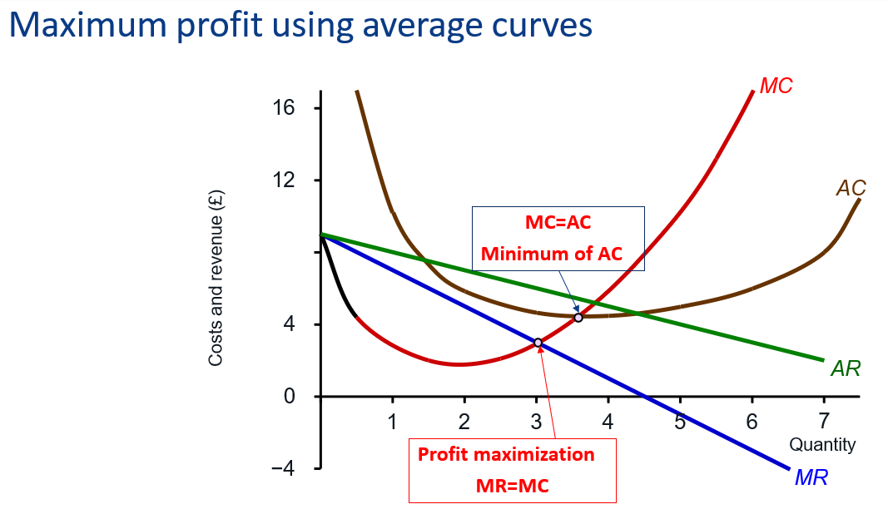
Question 10 (cont’d)

Slide 19
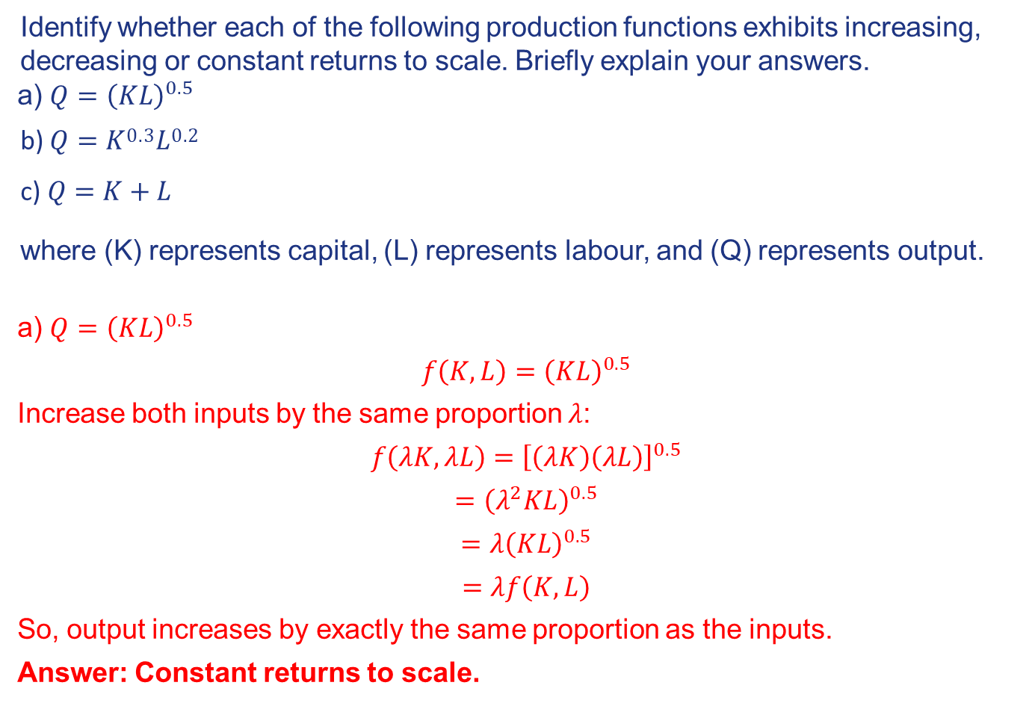
Additional question (Optional)
Identify whether each of the following production functions exhibits increasing, decreasing or constant returns to scale. Briefly explain your answers.
a) $Q={\left(KL\right)}^{0.5}$
_{b) 𝑄 = 𝐾}0.3_{𝐿}0.2
c) 𝑄 = 𝐾 + 𝐿
where (K) represents capital, (L) represents labour, and (Q) represents output.
a) $Q={\left(KL\right)}^{0.5}$
$$f\left(K,L\right)={\left(KL\right)}^{0.5}$$
Increase both inputs by the same proportion $λ$:
$$f\left(λK,λL\right)={\left[\left(λK\right)\left(λL\right)\right]}^{0.5}$$
$$={\left(λ^{2}KL\right)}^{0.5}$$
$$=λ{\left(KL\right)}^{0.5}$$
$$=λf\left(K,L\right)$$
So, output increases by exactly the same proportion as the inputs.
Answer: Constant returns to scale.

Slide 20
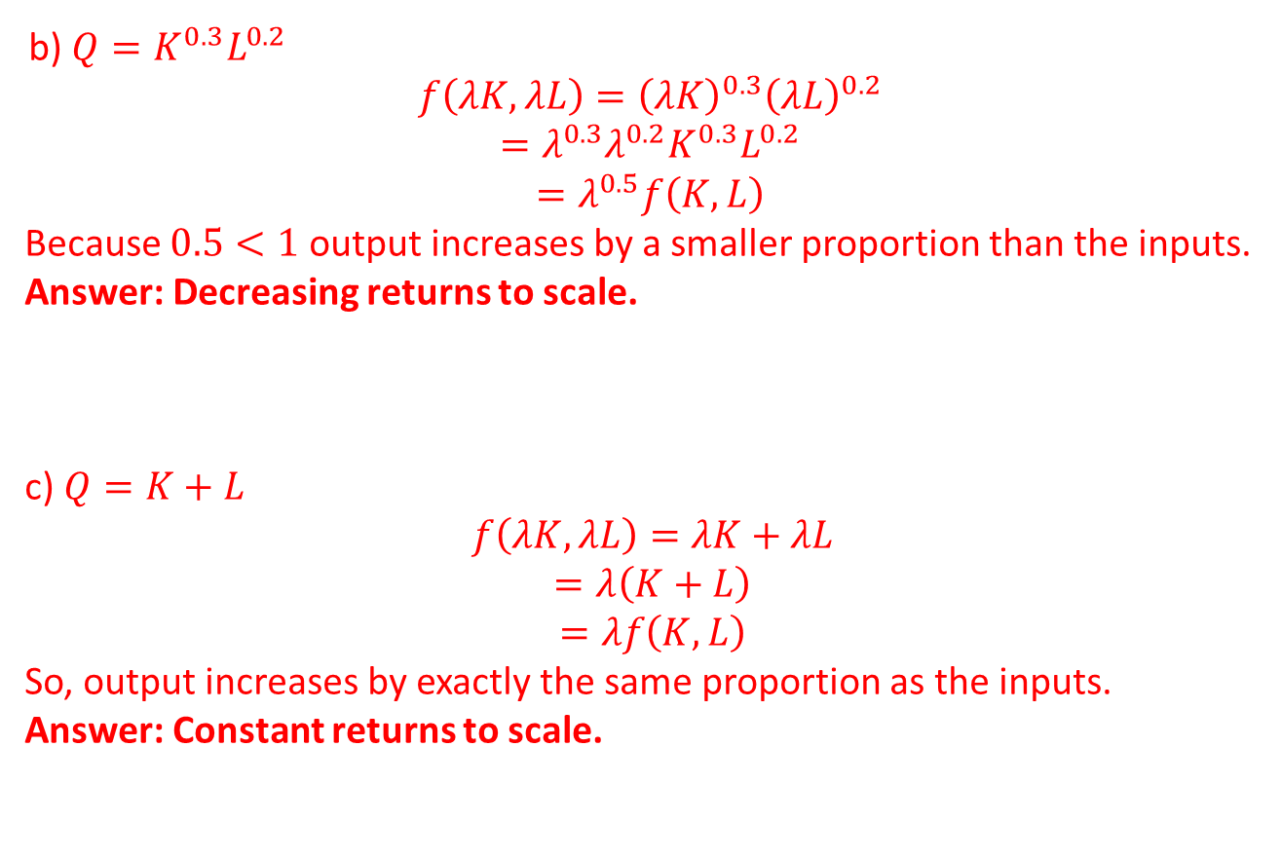
Additional question (Optional)
b) $Q=K^{0.3}L^{0.2}$
$$f\left(λK,λL\right)={\left(λK\right)}^{0.3}{\left(λL\right)}^{0.2}$$
$$=λ^{0.3}λ^{0.2}K^{0.3}L^{0.2}$$
$$=λ^{0.5}f\left(K,L\right)$$
Because $0.5<1$ output increases by a smaller proportion than the inputs.
Answer: Decreasing returns to scale.
c) $Q=K+L$
$$f\left(λK,λL\right)=λK+λL$$
$$=λ\left(K+L\right)$$
$$=λf\left(K,L\right)$$
So, output increases by exactly the same proportion as the inputs.
Answer: Constant returns to scale.

